Slide 1
SUPPORTING MULTI DATA STORE APPLICATION IN CLOUD ENVIRONMENT
TEAM MEMBER’S: GUIDE: ABILASH A BABY PRIYADHARSHINI P
MOHAMMEDUMAR M
MADHESWARAN P
PRATHAP SINGH B
DHAMODHARAN S

Slide 2
INTRODUCTION
Cloud computing has recently emerged as a new computing paradigm enabling on-demand and scalable provision of resources, platforms and software as services.
Due to its elasticity property, cloud computing provides interesting execution environments for several emerging applications such as big data management.

Slide 3
COND….
According to the National Institute of Standards and Technology (NIST), big data is data which exceed the capacity or capability of current or conventional methods and systems.
Volume means the processing of large amounts of information. Velocity signifies the increasing rate at which data flows.
Finally, variety refers to the diversity of data sources.

Slide 4
EXISTING SYSTEM
In our existing system implement the authorized searchable public-key encryption (ASPKE) scheme, in which a data owner decides the access policy for his encrypted data and keeps it hidden inside the ciphertext.
The AS-PKE scheme uses the access structure in form of LSSS.
If there are an attribute fields in the system, then only one value per attribute can be placed in the scheme to preserve the receiver anonymity.

Slide 5
DIS-ADVANTAGES
It is less effective when a ciphertext has multiple recipients with different attribute values for one attribute.
In this method provides more leakage information to the adversary.

Slide 6
PROPOSED SYSTEM
In our proposed system propose a single keyword based searchable encryption scheme for the applications where multiple data owners upload their data and then multiple users can access the data.
The Token Generator (TG) is a trusted third party of the system, which assists a data owner for generating encrypted index. TG is involved in the process of generating encrypted index.

Slide 7
COND….
For a small system/organization the AC itself can play the role of the TG.
Data owner encrypts and stores the data on cloud storage server. The encrypted data consists of two parts:
(i) the index of encrypted keywords
(ii) the encrypted document.

Slide 8
ADVANTAGES
In this method secure against chosen-keyword attack.
It facilitates a user to generate a trapdoor from his secret key autonomously without waiting for the token from any trusted authority which ultimately reduces the per-query interaction with the trusted third party and helps to gain efficient response time for search procedure.
Any user in the system is not be able to modify the key allocated to him or to generate a new key himself.

Slide 9
SYSTEM REQUIREMENT
HARDWARE REQUIREMENTS:
Processor : Intel Core i3
Ram size : 8GB
Hard disk capacity : 500 GB
SOFTWARE REQUIREMENTS
Operating System : Windows 10
Language : ASP .Net
Back end : SQL

Slide 10
FLOW CHART
Upload data
User
ABE
Encrypt
File retrieve
Decrypt

Slide 11
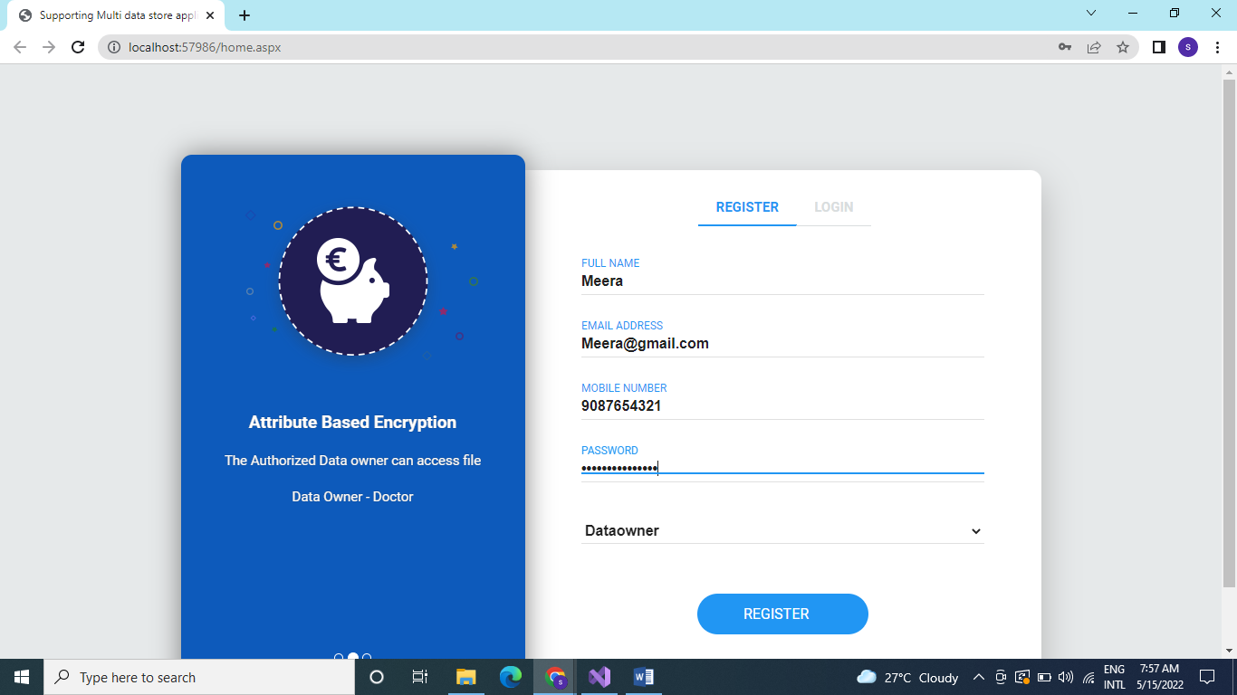
SCREENSHOT

Slide 12
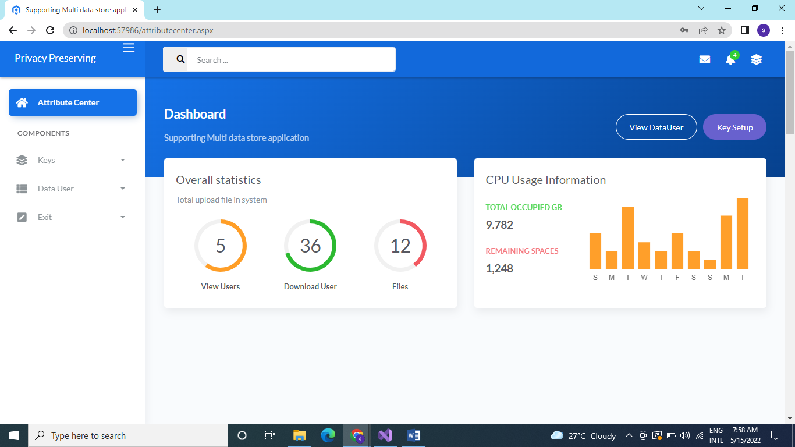

Slide 13
CONCLUSION
In this project, we proposed a generic approach to facilitate the developer task and enable the development of applications using multiple data stores while remaining agnostic to these later.
An Attribute based Encryption (ABE) algorithm is used to store the user information secretly in cloud environment which allows user to access the selective subset of data from cloud without revealing his/her access rights to the cloud server.
User Acceptance Testing is a critical phase of any project and requires significant participation by the end user.

Slide 14


Slide 15

THANKING YOU

